Slide 1
SVD Global Fitting and Pseudoinverse Analysis

Slide 2
Separation via Pseudoinverse (PInv)
Pseudoinverse matrix is the approximate inverse of a non-square matrix
A⁺A = AA⁺ = Identity matrix I
DF^{T} = USV^{T} = Approximate data matrix A
Spectral components corresponding to each tau are given in matrix D
DF^{T}F^{T+} = DI = D = USV^{T}F^{T+}
H = V^{T}F^{T+}
D = USH (Use this to get spectral components)
F^{T+} is pseudoinverse of transient component matrix
V^{T+}H = V^{T+}V^{T}F^{T+} = IF^{T+} = F^{T+}
Pseudoinverse of F^{T+} = F^{T} (transients)

Slide 3
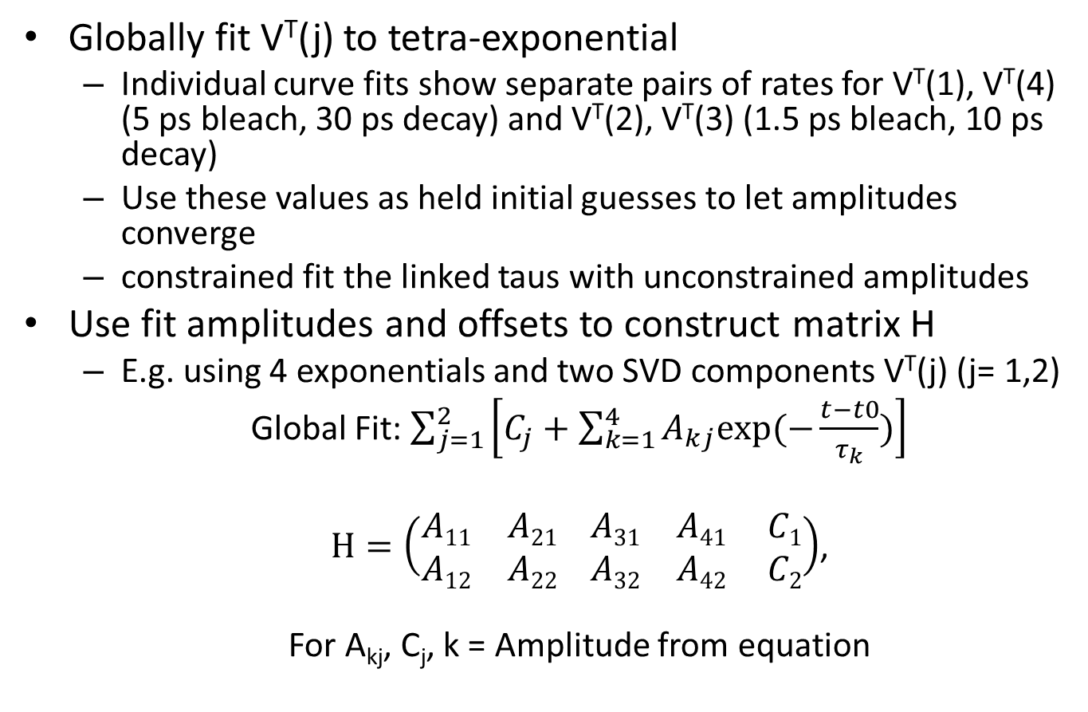
Global Fitting Details
Globally fit V^{T}(j) to tetra-exponential
Individual curve fits show separate pairs of rates for V^{T}(1), V^{T}(4) (5 ps bleach, 30 ps decay) and V^{T}(2), V^{T}(3) (1.5 ps bleach, 10 ps decay)
Use these values as held initial guesses to let amplitudes converge
constrained fit the linked taus with unconstrained amplitudes
Use fit amplitudes and offsets to construct matrix H
E.g. using 4 exponentials and two SVD components V^{T}(j) (j= 1,2)
Global Fit: $\sum_{j=1}^{2}{\left[C_{j}+\sum_{k=1}^{4}{A_{kj}exp⁡(−\frac{t−t0}{τ_{k}})}\right]}$
$H=\left(\begin{matrix}A11 & A21 \\ A12 & A22\end{matrix} \begin{matrix}A31 & A41 \\ A32 & A42\end{matrix} \begin{matrix}C1 \\ C2\end{matrix}\right)$,
For A_{kj}, C_{j}, k = Amplitude from equation

Slide 4
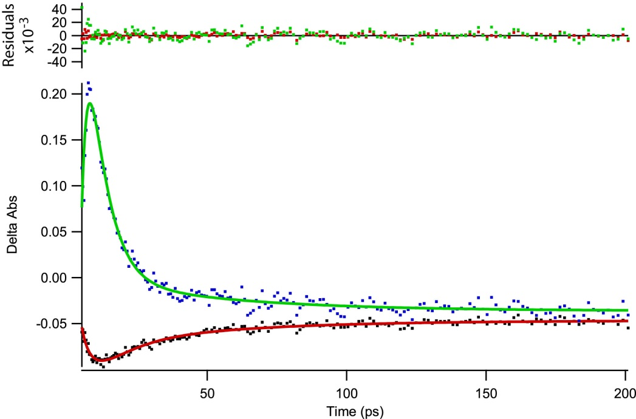


Global Fits and H-matrix from Rank 2 SVD
τ1 = 2.2 ps
τ2 = 6.3 ps
τ3 = 9.3 ps
τ4 = 49 ps
t₀ = -18.6 ps
$$H=\left(\begin{matrix}A11 & A21 \\ A12 & A22\end{matrix} \begin{matrix}A31 & A41 \\ A32 & A42\end{matrix} \begin{matrix}C1 \\ C2\end{matrix}\right)$$
$$H=\left(\begin{matrix}1265 & 5.7 & −1.7 \\ −21794 & 19.6 & 0.17\end{matrix} \begin{matrix}−0.05 & −0.047 \\ 0.06 & −0.036\end{matrix}\right)$$
VT(1) = Black Dots
VT(2) = Blue Dots
4-Exponential Global Fits:
VT(1) Fit = Red Curve
VT(2) Fit = Green Curve

Slide 5
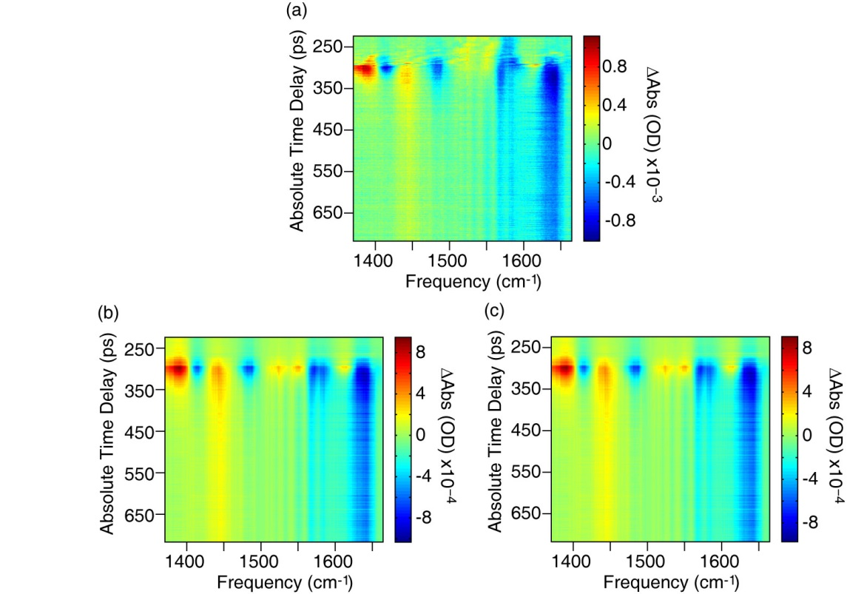
Rank 2 SVD and Pseudoinverse Comparison:
Rank 2 – Test PInv analysis method
Both SVD and PInv methods reproduce the important features of the raw data
PInv further refines SVD results
raw data
reproduced data from SVD truncated to Rank 2,
(c) global fit/pseudoinverse analysis of Rank 2 SVD

Slide 6
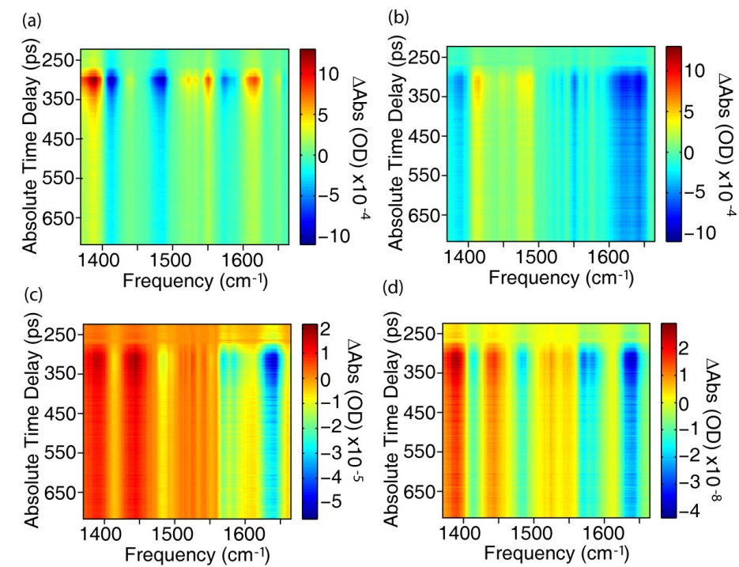
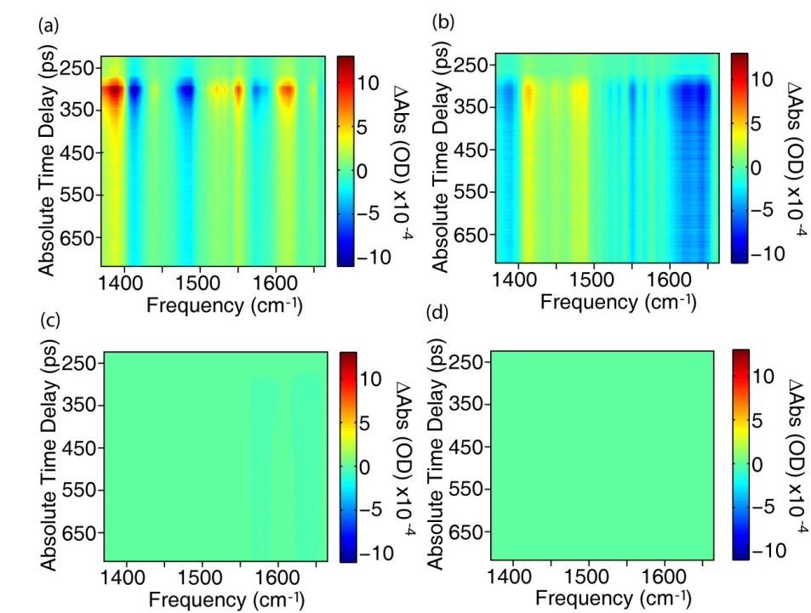
Pseudoinverse Analysis Results D(k)F^{T}(k) for V^{T}(j)=1,2
Contributions to Total PInv Data Matrix (a-d) = D(k)FT(k) k = 1-4, respectively
Raw amplitudes (left), scaled to D(1)F^{T}(1) (right)

